Slide 1
Session-4
Financial Management
Risk and Return

Slide 2
Return
Return is the amount of money you receive from an investment
A return is often calculated as a percentage or ratio of the original investment, so that managers can measure and compare how well their investments are performing.
Amount of return depends on a lot of different things, but the main driving force is risk.

Slide 3
Types of Return
Realized Return or Historical Return
Expected Return

Slide 4
Realized Return
Return of an investment consists of two components
Current Return: Periodic cash flow such as dividend and interest
Capital Return: Price appreciation over a period of time
Total Returns = Current Return + Capital Return
Total Return = Cash payment received + Price change over a period of time
Purchase price of the assets

Slide 5
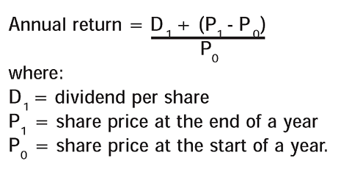
Conti…

Slide 6
Example-1
A invested in the share of TMH corporation at a price of 300 Rs per share. He purchased 200 shares. After one year he sells these share at a price of 360 per share and also received the dividend of 10 Rs per share. Find out the total return earned by A.

Slide 7
Conti…
Example-2
X purchased the share in 200o at 52 Rs. Calculate return in below condition.
Total holding period return If x sells the share in the end of 2006.
Average annual return
Year | Dividend | Year End Price
2001 | 1.95 | 58
2002 | 2.02 | 71
2003 | 2.13 | 63
2004 | 2.28 | 75
2005 | 2.5 | 84
2006 | 2.72 | 92

Slide 8
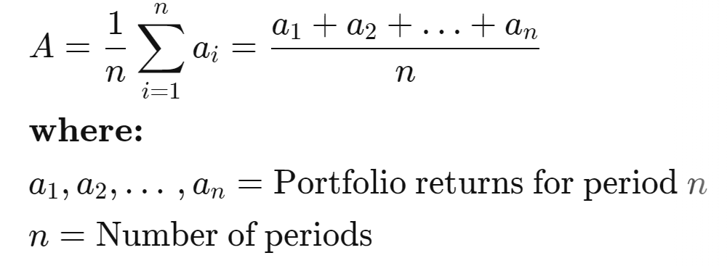

Computing Average Annual Returns
Arithmetic Mean Return
Geometric Mean Return

Slide 9
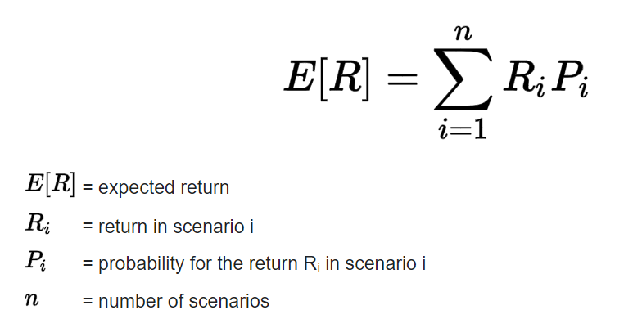
Expected Return
The expected return is the amount of profit or loss an investor can anticipate receiving on an investment.
An expected return is calculated by multiplying potential outcomes by the odds of them occurring and then totaling these results.
Expected returns cannot be guaranteed.

Slide 10
Example-3
X Purchased the share of Pharma ltd and following are the information available. You are requested to calculate the expected return
State of Economy | Probability | Rate of return
Strong | 0.15 | 0.2
Weak | 0.15 | -0.2
No major change | 0.7 | 0.1

Slide 11
Example-4
Ajay has bought 150 shares of Hindalco@120 each. He predicts two scenarios (1) optimistic and (2) pessimistic for calculating expected return. The probability assigned to both the scenarios is .7 and .3 respectively. Ajay predicted that under optimistic scenario Hindalco share would rise to 200 Rs and under pessimistic scenario, he predicts that price to touch 150 only. Calculate the expected return of Hindalco stock using the given data.

Slide 12

Real Rate of Return

Slide 13
Risk
In finance, risk is the probability that actual results will differ from expected results
Risk is defined in financial terms as the chance that an outcome or investment's actual gains will differ from an expected outcome or return. Risk includes the possibility of losing some or all of an original investment.Such variation in the returns results from
External factors-(Systematic Risk) (which can not be controllable by the firm and affect large number of stocks
Internal factors – (Unsystematic Risk) ( internal to the firm and controllable to a large degree
Total Risk = Systematic Risk +Unsystematic Risk

Slide 14
Systematic Risk
Systematic Risk is defined as the risk that is inherent to the entire market or the whole market segment as it affects the economy as a whole and cannot be diversified away and thus is also known as an “undiversifiable risk”
Systematic risks, are risks that can affect an entire economic market overall or a large percentage of the total market.
Systematic risk is the risk of losing investments due to factors, such as political factors and macroeconomic factors, that affect the performance of the overall market.
Systematic risk cannot be easily mitigated through portfolio diversification. Other common types of systematic risk can include interest rate risk, inflation risk, currency risk, liquidity risk, country risk, and sociopolitical risk.

Slide 15
Components of Systematic Risk
Interest-Rate Risk: It refers to the risk arising out of the change of market interest rates and affects fixed income instruments like bond
Market Risk: It refers to risk arising out of changes in the market price of securities which causes a significant fall in the event of a stock market correction
Exchange Rate Risk: It arises out of changes in the value of currencies and affects corporations with substantial foreign exchange transaction exposure
Political Risk: It is mainly due to political instability in any economy, and it affects business decisions

Slide 16
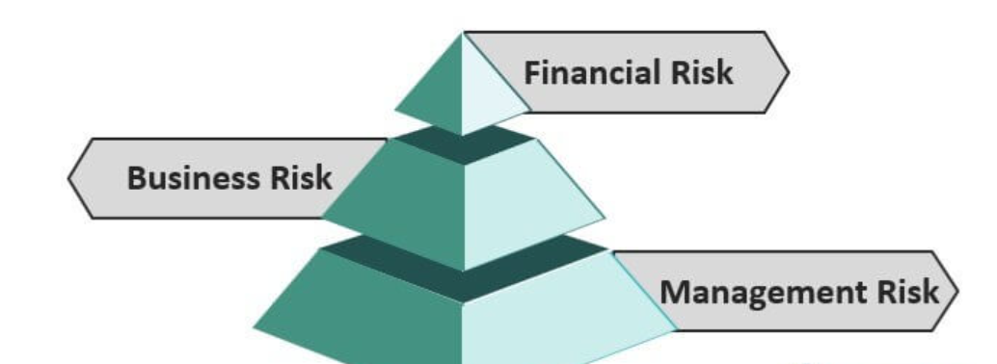
Unsystematic Risk
Diversifiable risk, also known as unsystematic risk, is defined as firm-specific risk and hence impacts the price of that individual stock rather than affecting the whole industry or sector in which the firm operates.

Slide 17
Components of Unsystematic Risk
Business risk arises because of the challenges a firm faces while doing business. They can be both internal and external but are only specific to the firm.
Financial risk is the uncertainty introduced by the method by which the firm finances its investments. If a firm uses only common stock to finance investments, it incurs only business risk.
Management risk is the riskiest and most difficult to manage segment for the firm. Change in leadership has a huge impact as there is always a threat of close associates of the outgoing leader also resigning.

Slide 18
Measuring Historical Risk
Standard deviation of rates of return
Variance of rates of return
Coefficient of variation of rates of return (standard deviation/means)
Beta: Covariance of returns with the market portfolio

Slide 19
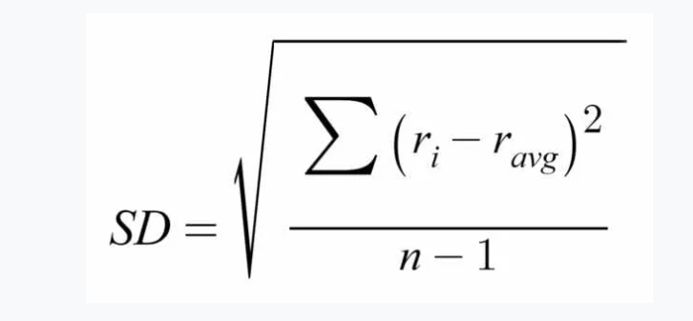
Standard Deviation
Standard deviation is a measure of the variation, or dispersion, in data.
It tells us how spread out the values are around their mean.
It is calculated by subtracting each value in a data set from its mean, squaring the value, averaging all squared values, and finally taking the square root of the average.

Slide 20
Example-5
Following are the return data of Maruti Ltd share. Calculate the standard deviation from the data provided
Year | Returns in %
1 | 15
2 | 12
3 | 20
4 | -10
5 | 14
6 | 9

Slide 21
Example-6
Mohan purchased the share of X Ltd in 2001 at a price of 180 Rs per share. Following historical closing prices and the dividend data is provided for X ltd Share for last 10 years. Calculate the rate of return as well as the risk (Standard Deviation) on the share of X Ltd
Year | Dividend | Closing Price
2002 | 5 | 200
2003 | 6 | 220
2004 | 6 | 240
2005 | 7 | 290
2006 | 7 | 270
2007 | 8 | 325
2008 | 8 | 240
2009 | 9 | 380
2010 | 9 | 380
2011 | 10 | 425

Slide 22
Coefficient of Variation
SD and variance is the absolute measure of risk.
But some time we are keen to find out the relative measure for that we use Coefficient of Variation.
Coefficient of Variation = SD/Expected Average Return

Slide 23
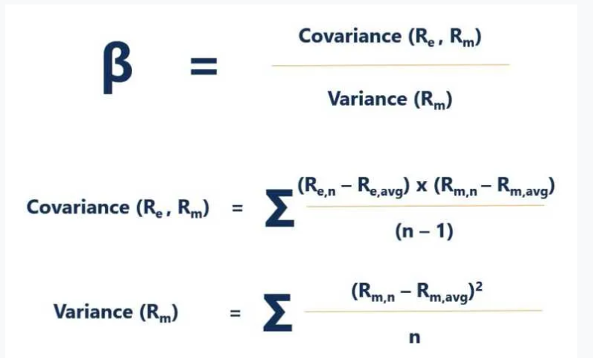
Beta
The Beta coefficient is a measure of sensitivity or correlation of a security or an investment portfolio to movements in the overall market.

Slide 24
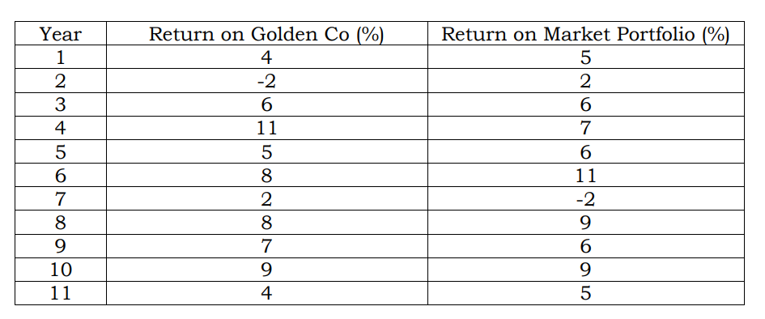
Example -7
You are a student of an elective course on financial management. Recently, the course instructor discussed about the concept of beta. As a stock market enthusiast, you are interested in calculating beta of Golden Co.

Slide 25
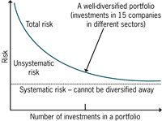
RISK AND RETURN OF A PORTFOLIO
Most investors invest in a portfolio of assets, as they do not want to put all their eggs in one basket.
Hence, what really matters to them is not the risk and return of stocks in isolation, but the risk and return of the portfolio as a whole

Slide 26

Expected Return on a Portfolio
The expected return on a portfolio is simply the weighted average of the expected returns on the assets comprising the portfolio.
In general, when a portfolio consists of n securities, the expected return on the portfolio is:

Slide 27
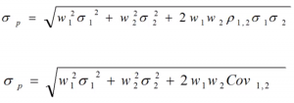
Diversification and Portfolio Risk

